Slide 1




Sociology of Work
Introduction
Adam Standring, PhD.

Slide 2

Professor
Adam Standring
astandring@iseg.ulisboa.pt

Slide 3
Classroom Values
Curiosity
Openness
Participation
Respect

Slide 4
Programme
Sociology of work: an introduction
Socio-economic transformations: main trends and consequences for professions and labour relations
New models of organization within firms
The diversity of systems of industrial relations, trends and challenges

Slide 5
Programme
Socio-economic transformations: main trends and consequences for professions and labour relations
  2.1. Information and communication technologies
  2.2. Changing professional structures
  2.3. Workforce changes and labour segmentation
  2.4. Flexibility in labour relations and new forms of work

Slide 6
Programme
New models of organization within firms
  3.1. The diversity of new forms of work organization
  3.2. Quality of working life and dignified work
  3.2. Inclusive forms of work organization: examples around gender equality and work-life balance

Slide 7
Programme
The diversity of systems of industrial relations, trends and challenges
  4.1. Different models of national industrial relations systems
  4.2. Present challenges for trade unions
  4.3. New forms of participation and negotiation

Slide 8
Assessment criteria and evaluation processes
1. “Época normal” (Regular assessment method)
1.1. Ongoing assessment during the course (40%) and “Época normal” exam (Regular assessment period) (60%)
Ongoing assessment comprises:
a) Group activities (1/2 of the grade for the ongoing assessment):
  There will be 6 group activities done in class. Each will entail the delivery of a written essay (typically about 600 words).
  Each completed essay will be awarded 2 values – groups completing all essays will thus get 12 values, or 10 values if only 5 essays are handed in and so on. Essays must directly address the question(s) or task(s) for that group activity.
  Each group will be randomly assigned one group activity to be presented and for which group members will answer questions – assignment is communicated after each activity is completed. If successful in presenting and answering the questions, each group with receive up to a maximum of 8 points in addition. The assessment grid for these 8 points is presented in a following slide.
b) Formal group exercises (mid-terms) (1/2 of the grade for the ongoing assessment).
  Slides and textbooks are allowed. No laptops or mobiles. There are 2 formal group exercises. Best grade between the two prevails.
“Época Normal” individual written test (exam): 60% of the final grade (or 100%, whatever is more beneficial)
  A minimum grade of 7 is required for the grade obtained in the ongoing assessment to be considered. Grade >17: + oral exam. No external resources (‘closed book’).
1.2. An individual written test (exam) - “Época Normal”: 100%

Slide 9
Assessment criteria and evaluation processes
If students…
  … did not opt for the previous evaluation process (“Época Normal”); OR
  … failed the semester (”Época normal”); OR
  … wish to improve their grades.
2. Written individual test (“Época de recurso”): 100%
  Not allowed to consult any material
  If undertaken ongoing assessment during the course/semester: rules under 1.1 apply
  For improvement of grades: exam is worth 100%

Slide 10
Assessment grid for the group activities
Each group member must be able to thoroughly defend and justify the essay, explain and apply the concepts included there and refer back to the literature in a specific way.
Specifically:
Presentation: the structure of the presentation allows for the main topics of the essay to be conveyed to the audience, slides are clear and readable, students make correct use of presentation techniques (intonation, no or only very exceptional reading of notes). 2 values.
Concepts: ability to explain in detail the main concepts used, with examples if necessary, and how they relate to the questions posed for the essay. 2 values.
Applied knowledge: ability to apply the concepts and terms used in the lectures, reflect on main advantages and shortcomings of the concepts and data used, situate the concepts in the broader programme of Sociology of Work or relate to other concepts discussed in this course. 2 values
Replicability: ability to demonstrate which sources were used and how, how results were generated and ability to replicate them in a similar context. 2 values.
ATTENTION: Groups may be called up to present more than once, if there are doubts about their commitment to the ongoing assessment following their presentation

Slide 11
For open questions in group activities, mid-terms, final exam remember...
The question is never: “Write everything you remember about topic XYZ”. Make sure you address the question.
Whenever relevant…
  Refer back to arguments, models and concepts discussed in the lectures and use them to support your views/opinions and to answer the question.
  Explain the possible causal links (why A leads to B).
  Link different subjects or points in the program. The program is interdependent (Robert Reich may provide arguments to understand female labour market participation or different types of labour relations may be linked to different models of work organization)
Answers are not graded based on keywords… we actually read the whole text! ☺

Slide 12
Consider the following examples:
You prepared the meals and washed the dishes for a relative who is unable to get out of bed
You prepared your own meal and washed the dishes afterwards
You are paid by a company with whom you have an employment contract to prepare the meals and wash the dishes for older people who are unable to get out of bed
You paid someone to prepare your meals and wash the dishes afterwards
Which of the above is work? Which is employment?

Slide 13
Main concepts: work, employment and firms
WORK involves all activities, either paid or non-paid, related to the production and distribution of goods and services.
- market
- non-market activities (with social utility)

Slide 14
Main concepts: work, employment and firms
EMPLOYMENT
Paid work, commodification of work
Different status (subordinated employment; self-employment...)
Different working time regimes
Different levels of labour protection

Slide 15
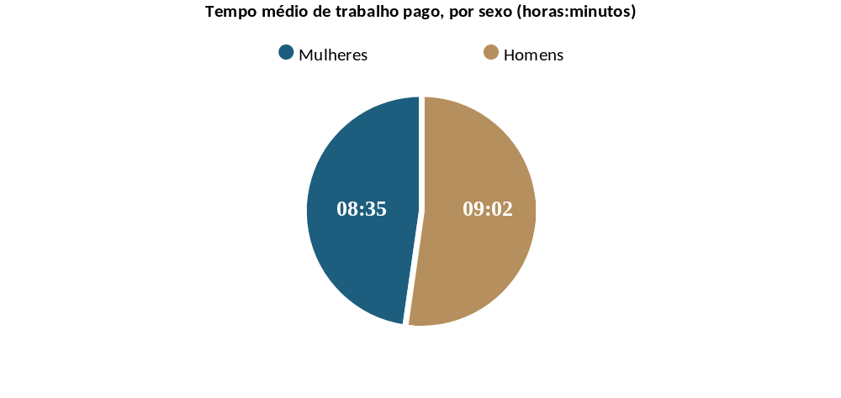
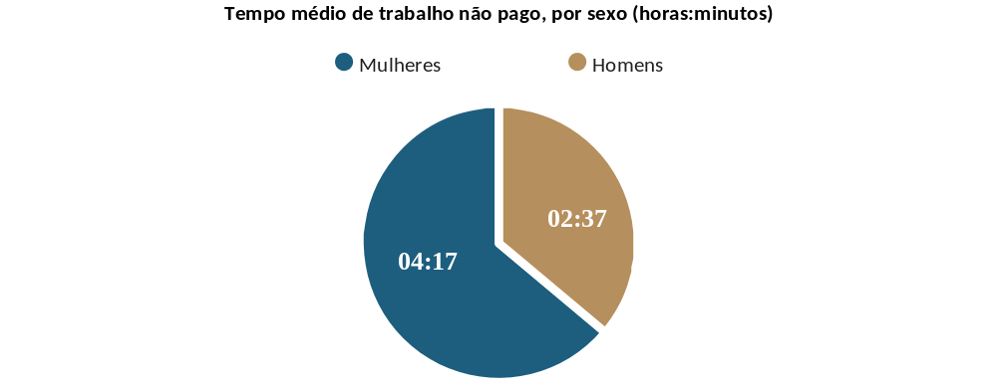
Gendered concepts
Average time on paid work, by sex (hours: minutes)
Average time on unpaid work, by sex (hours: minutes)
Women
Men
Women
Men
Source: Perista, H, et al (2016), Os usos do tempo de homens e de mulheres em Portugal, Lisboa, CESIS / CITE. Based on the Harmonized Time Use Survey.

Slide 16
Main concepts: work, employment and firms
The FIRM is no longer a place for the production of goods and services…
Change of paradigm
The FIRM is as a micro-society:
A social and cultural space, where values, social representations, rules, collective identities, sociability networks and subcultures and (re)produced...
Cultural dimensions are manageable
Organisational cultural is therefore seen as an important ingredient for efficiency and competitiveness

Slide 17
The evolution of sociology of work
The 1960s:
Focus on working conditions
Degradation of working conditions
Alienation
Deskilling
Labour movement and class struggle
The 1980s:
Focus on the workplace as an empirical object
Firm=space of socialisation and integration
Production relations and social relations

Slide 18
The evolution of sociology of work
Nowadays:
Information and communication technologies, globalization
Employment (in)security
Flexible forms of work (contracts, working time, space…)
Informal work
Non-paid work, work-family life reconciliation
Inequalities: global (e.g. care chains), gender, migration

Slide 19

Examples of real world applications

Slide 20
Action Research - methodology
Diagnosis
Problem identification
Evaluation
Obtained results versus expected results
Intervention
Structured activities, supported by techniques intended to reach the organisation as a whole

Slide 21
Organizational change
Diagnosis
Problem identification
Technical system
Social system (formal and informal)
Organizational structure
Organizational processes
External context
Individual questionnaire
Evalution of managment/leadership style

Slide 22

Organizational change
Visible/Formal Aspects
- Objectives
- Technology
- Structure
- Procedures...
Informal/Hidden Aspects
Perceptions
Attitudes
Feelings
Values, group norms
Interactions

Slide 23

Organizational change
Interpersonal interventions
e.g. enhance individual skills, conflict resolution
Group interventions
e.g. to enhance communication, facilitate a better balance between both personal and group needs
Intervention
Structured activities, supported by techniques intended to reach the organisation as a whole
Evaluation
Obtained results versus expected results

Slide 24
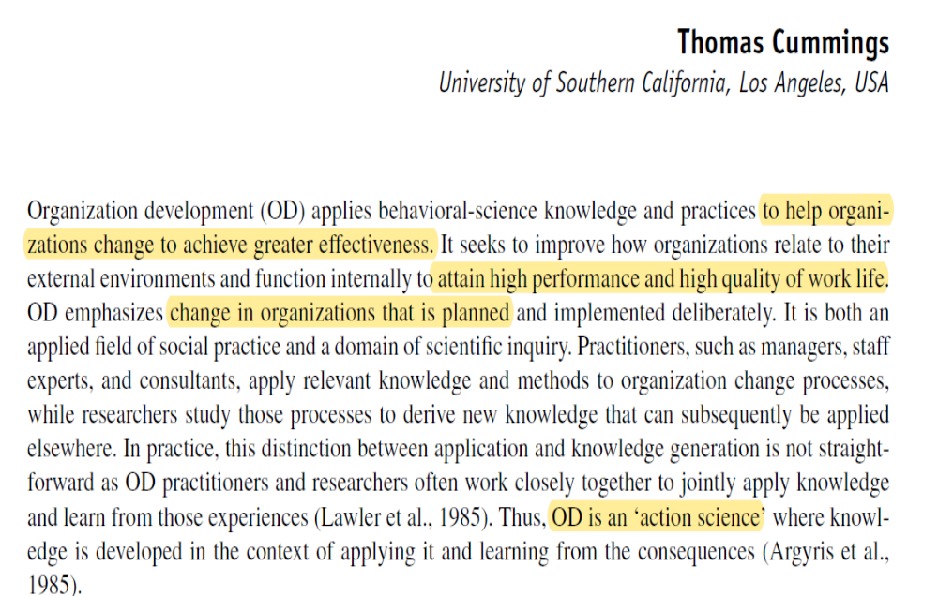
Organizational Development

Slide 25
Kotter’s 8-Step Change Model
Watch the video:
https://www.youtube.com/watch?v=22coAwMD9M0

Slide 26
Organizational Development
Methods and aims:
Social psychology: group dynamics, T-group techniques (Lewin, 1946)
Sociology: Open System, Sociotechnical System, Action Research
Individuals, groups, organizations and context/environment
Collaborating ethos between consultants and organization
Aims to improve the organisational performance both in terms of adaptation to external environmental and adjustments at an internal level

Slide 27
Organizational Development
Resisting change:
Uncertainty as to the causes and effects of change
Change perceived as threatening
Large changes
Externally-driven changes
Resentment, unresolved conflicts
Intransparent

Slide 28
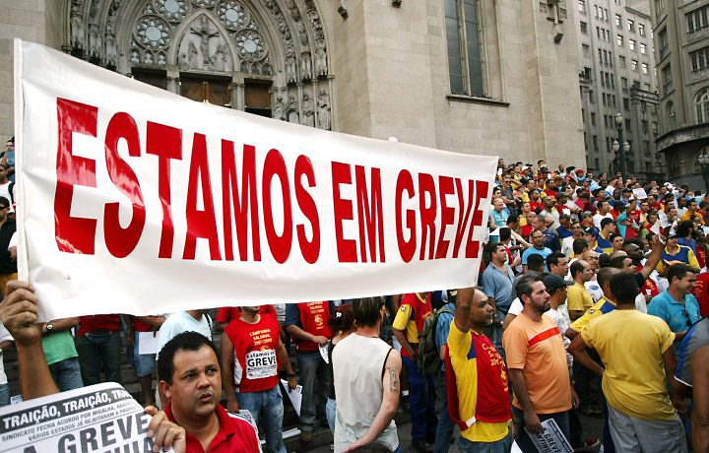
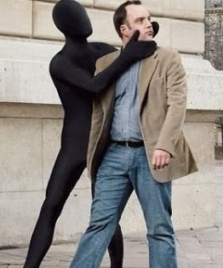
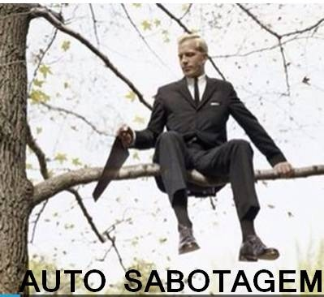
Organizational Development
Forms of resistance
Passive stance
Indiference
Negligence
Sabotage
Industrial action and conflicts

Slide 29
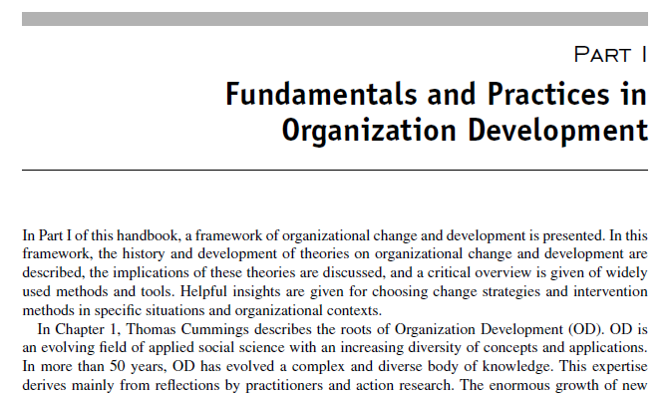
Essential reading
CUMMINGS, T. (2004), “Organizational Development and change”, in J. Boonstra, Dynamics of Organizational Change and Learning, Chichester, John Wiley & Sons, pp. 25-42.

Slide 30
Next lecture: practical exercise organizational change
In class material is mandatory
Please print out material 1 (Institute of Law)

Slide 31


www.iseg.ulisboa.pt

